Slide 1
RAJALAKSHMI ENGINEERING COLLEGE
Department of Artificial Intelligence and Machine Learning
AI19P52 AI for Game Programming
MINI PROJECT
ENDLESS RUNNER IN 3D
Project by,
PRAGATHEESH K (201501037)
LOKESH K(201501501)
JEEVAN M M (201501504)
TINKU VIGNESH S(201501505)

Slide 2
OUTLINE
Objectives
Abstract
Introduction to Problem Domain
Existing system
Limitation of the Existing System
Proposed system
Architectural design for Proposed system
ER ,Use case Diagram
Algorithm/Technique Used
Module Description
Results and Discussions
References

Slide 3
OBJECTIVE
To reach the end of the level without falling into or colliding with the obstacles.
The level repeats itself infinitely, gradually increasing the difficulty, until the player collides with the obstacle.
To reach a high score by surviving for as long as possible

Slide 4
ABSTRACT
Endless runner in 3D which is the endless running game it consist the player Joe who want to run as far as possible to catch the thief who is running front of the Joe . The player want to collect the coin which has been left by the enemy and avoid obstacles which is on the environment and run continuously to set the high score . The player can move left and right to avoid the obstacles when the player hits the obstacles the player fall down and the game gets over . Its very interesting to play the game it gives the realistic feel that we are running to catch the thief .
Endless runner 3D game will increasing difficulty as the player run further. In Endless runner 3D the environment is designed more interesting like the street which contain the big building and the obstacles that like some destroyed van, barricades, old tires , and some road blockers which is used to block the lane and this environment road consist of two lane . Endless runner 3D developed for PC ,MAC,LINUX . This 3D game was made using the Unity game engine with C# as the programming language. Some players feel interested in playing, but there are challenges, a pretty difficult to the user.

Slide 5
INTRODUCTION TO PROBLEM DOMAIN
• Endless runner is a video game genre of
action game.
• In a endless runner the player controlled
character must move between given platforms while avoiding obstacles
environments often feature uneven terrain of varying height that must be traversed.
• The player often has some control over
the height and distance of jumps to avoid
letting their character fall to their death or miss necessary jumps.
The most common unifying element of games of this genre is the jump button, but now there are other alternative like swiping a touch screen.

Slide 6
EXISTING SYSTEM
Sr. No | Author(s) | Year | Technique | Description | Outcome
01 | Imangi | 2011 | PLG | The player controls an explorer who has obtained an ancient relic and runs from demonic monkey-like creatures chasing him. | Endless running video game
02 | Kiloo | 2012 | PLG | The aim of the game is to outrun a train inspector while dodging oncoming trains, barriers and other objects | Endless running video game

Slide 7
LIMITATIONS OF EXISTING SYSTEM
Sr. No | Limitation
01 | The game only used in android appliation.
02 | The best score of 2,147,483,647 points cannot be beaten.
Date Slide Number

Slide 8
PROPOSED SYSTEM
A single player running game, in which the player character is continuously moving forward through an endless game world.
Two important elements in the game are obstacles and coins.
The player has to avoid obstacles than it is use to increase score.
The one and only goal of this game is to catch the thief and collect the coins.
The score is counted as the distance that the character travels, and while running, the player can collect coins to increase number of coins .
The player only has one life; if the player’s character falls down , the game gets over.

Slide 9
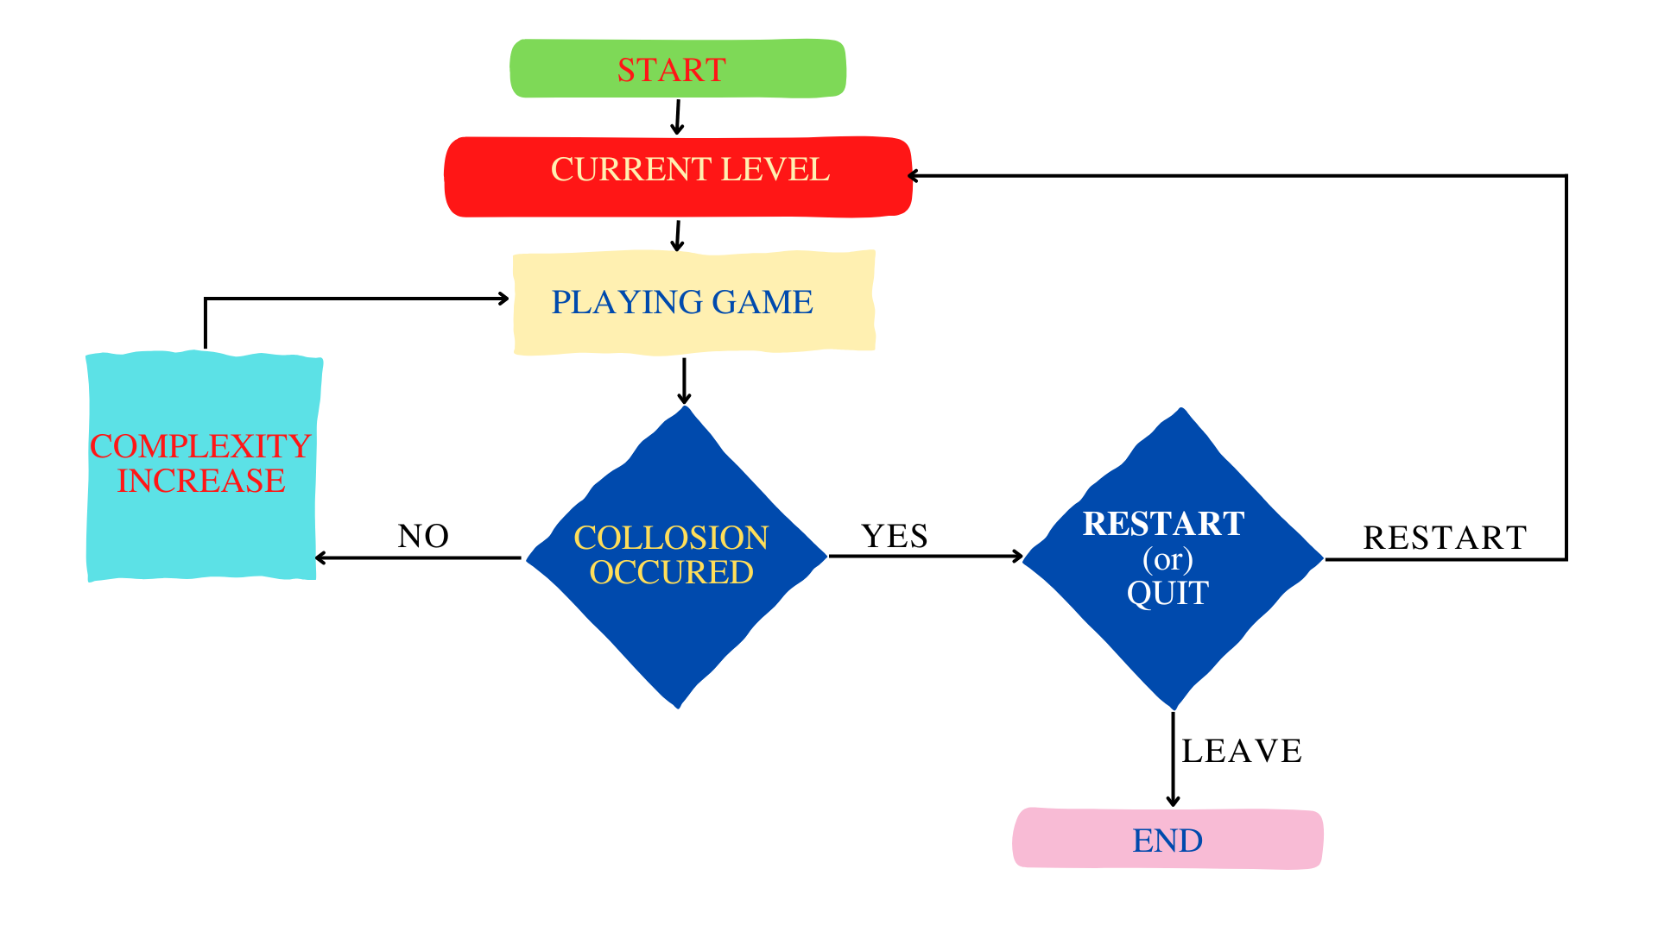
ARCHITECTURAL DESIGN FOR PROPOSED SYSTEM

Slide 10
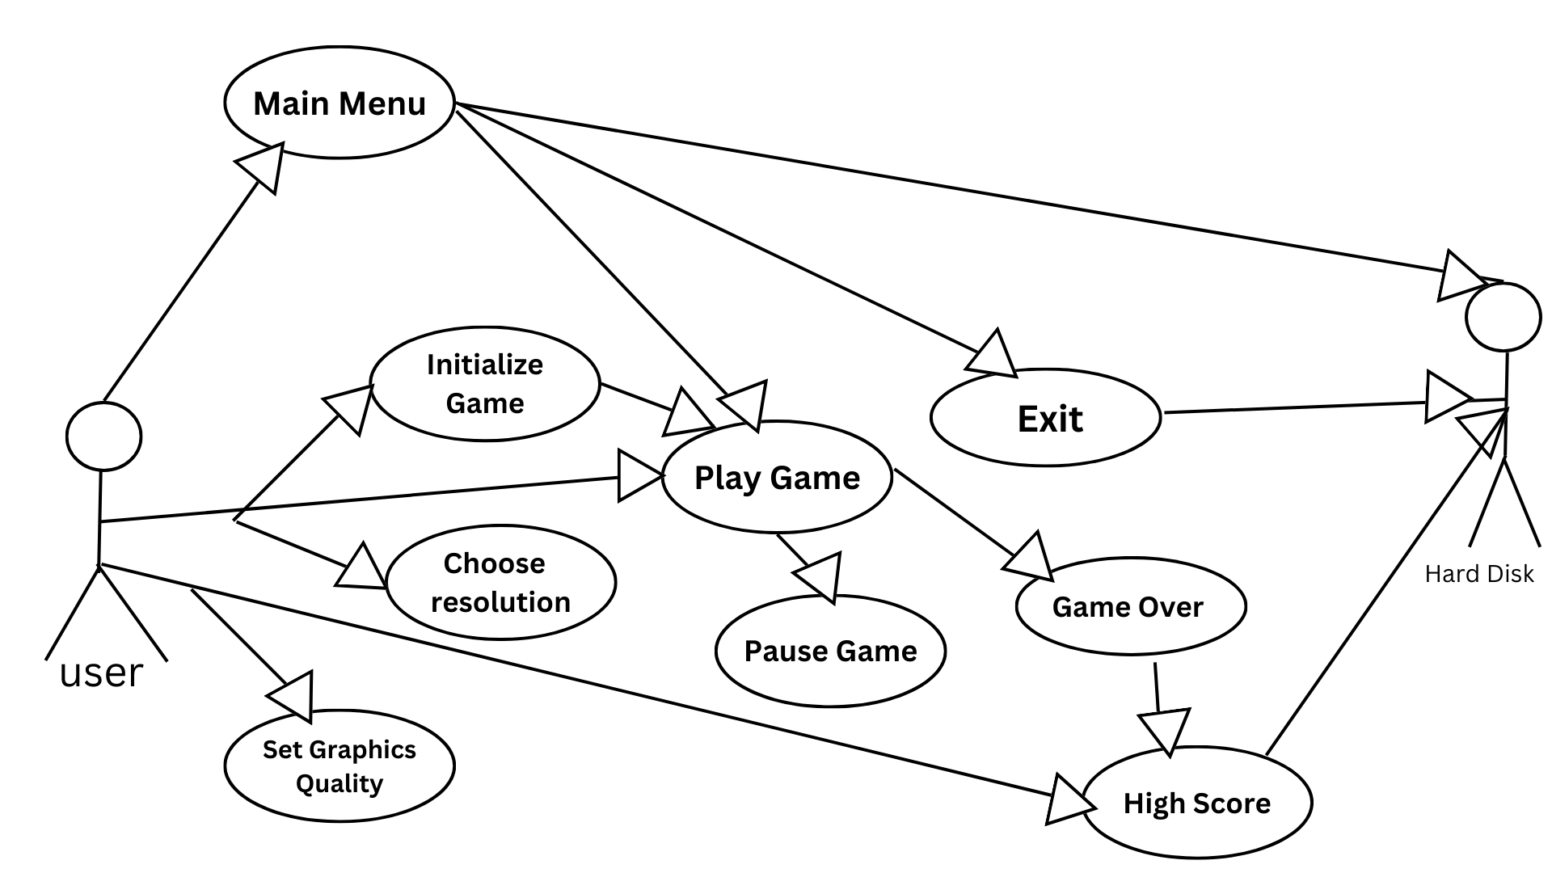
USE CASE DIAGRAM

Slide 11
ALGORITHM/ TECHNIQUE USED
TECHNIQUES USED :
Infinite terrain generation.
Random obstacle placement
Collision detection.
moving controls.
ALGORITHM :
Step 1 : Start the game.
Step 2 : Click the play button to enter into the game world
Step 3 : Start chasing the enemy and collect the coin as much as possible .
Step 4 : After reaching the particular distance the objects get closer and the player should
avoid and run .
Step 5 : If the Player collides with any of the obstacles, then the game ends.
Step 6 : Restart the game and go to step 2.
Step 7 : End the game.

Slide 12
Results and Discussions
During this project, all the basic features were achieved completely endless running game on a PC platform. All the game assets were created by myself with Photoshop software. In addition, all the assets in the game have some components to contact with other objects in the game. For the game play, the game player can control the character to jump and reach other grounds by right-clicking the mouse. The game points are increasing when the game goes on. Also, there are coins that can give bonus points and the monsters on the grounds that the player should dodge. The character dies, if he touches the monster. Then the score will be settled. If the new score is higher than the score record, the previous high score will be replaced by the new one. The main goal in this game is to get more points and break the old high score records. However, the way of running this game out of the Unity 3D engine is to run the exe file which is created from the Build & Setting tool.

Slide 13
ADVANTAGE OF PROPOSED SYSTEM
Players can run at insane speeds through an infinite procedural world to experience the nerve-wracking tension of the endless runner video game.
Players get to experience the real world through the runner game with sound effects.
Players can collect, Tris to boost their gaming score.

Slide 14
Conclusion
We believe that computer game AI will be the next revolution in the gaming industry. After the impressive advances in the audiovisual presentation and the networking capabilities, the next step in computer games is to incorporate advanced AI techniques that can achieve the goal of having truly adaptive games, increasing the level of believability and immersion. To achieve this goal, the gaming community needs new techniques, approaches and tools that allow them to easily specify, develop, and incorporate AI in their games.

Slide 15
REFERENCES
Gameplay Balance. WWW-doucument. http://www.theoryofgaming.com/importance- gameplay-
Hiscott, Rebecca. 2014. 10 Programming Languages You Should Learn Right Now. WWW- doucument. http://mashable.com/2014/01/21/learn-programming-languages/#gl6J3bZOskqL
Controller, Animation States. WWW-doucument. http://docs.unity3d.com/Manual/class-

Slide 16
THANK YOU

